Slide 1


DATA ANALYSIS AND ANALYTICS USING WEKA AND TABLEAU TOOL FOR DATA MINING AND MACHINE LEARNING

Slide 2
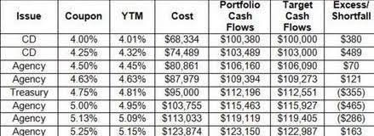
DATA SET
a collection of data
Arranged in columns and rows
Ex:

Slide 3

In class
Apple:
*It is red in colour
*It is a fruit
*It is good for health
*It is round in shape

Slide 4



In exam
Find Which is apple

Slide 5
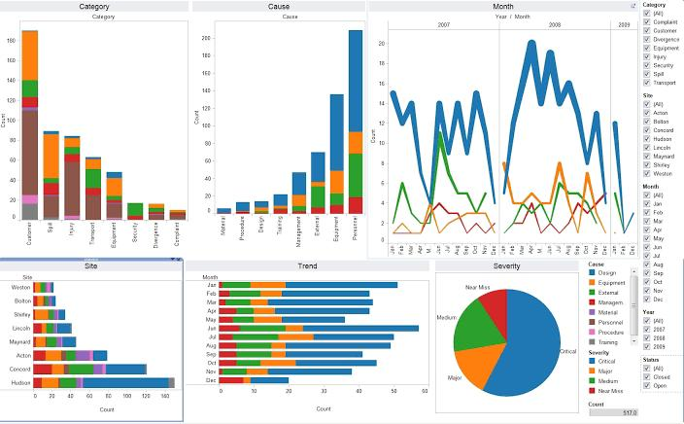
Data visualization

Slide 6
Need of data analysis
To understand growth of business.
To know profits/loss.
To understand requirements of customers/clients.
Demands on products.
To know flow of transactions.
Stock maintenance.
To know needs of visitors (website or apps).
Ex: Google ads, Amazon, search bar suggestions.

Slide 7
Tools for data analysis and Visualisation
There are plenty of tools for data analysis.
Excel
Jupyter
WEKA
Tableau
Google Analytics
Orange
Etc.

Slide 8


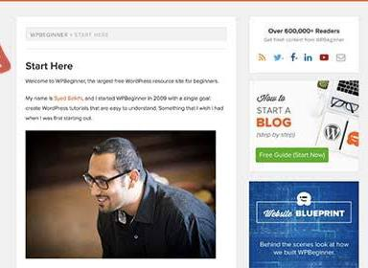
Instant solutions

Slide 9
Why weka and Tableau for analysis?
Eassy to use
User friendly
No programimng required
Drag and drop
Time saving
Requires Short time to learn and understand
Instantanious
Accurate
Etc.

Slide 10
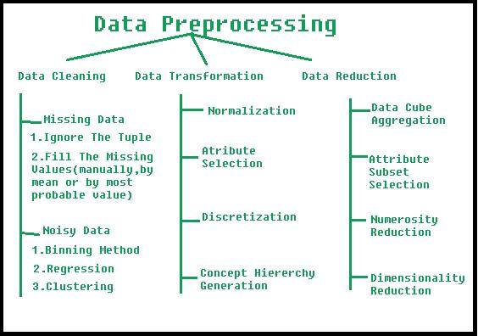

Slide 11
Data Cleaning
1)Get Rid of Extra Spaces
2)Select and Treat All Blank Cells
3)Remove Duplicates
4)Convert Numbers Stored as Text into Numbers
5)Highlight Errors
6) Use Find and Replace to Clean Data in Excel
7) Change Text to Lower/Upper/Proper Case
8)Spell Check

Slide 12
WEKA TOOL
Open your CSV file in the ARFF-Viewer by clicking the File menu and select Open. files (*.csv). Select your file and click the Open button. You should see a sample of your CSV file loaded into the ARFF-Viewer. Save your dataset in ARFF format by clicking the File menu and selecting Save as…. Enter a filename with a .arff extension and click the Save button.

Slide 13
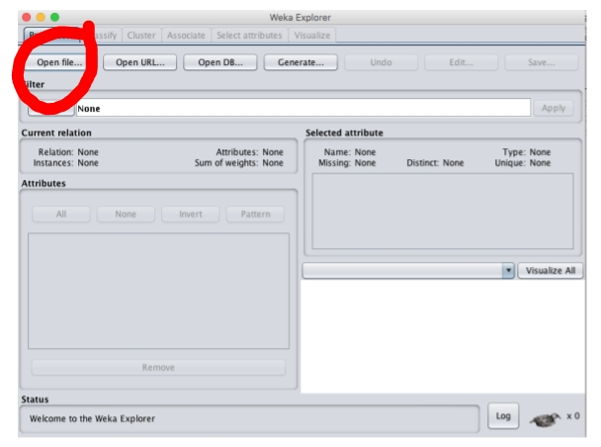
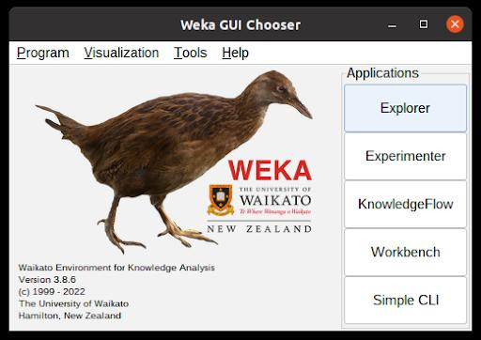
Data transfering
WEKA Tool

Slide 14
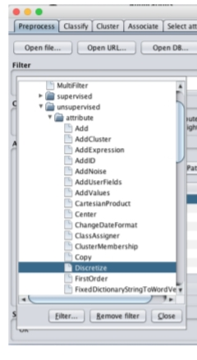
Filtering

Slide 15
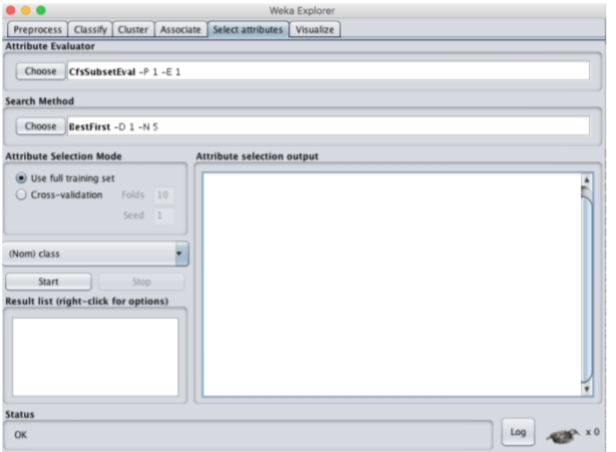
Attributes selection
Based on our requirements and accuracy

Slide 16
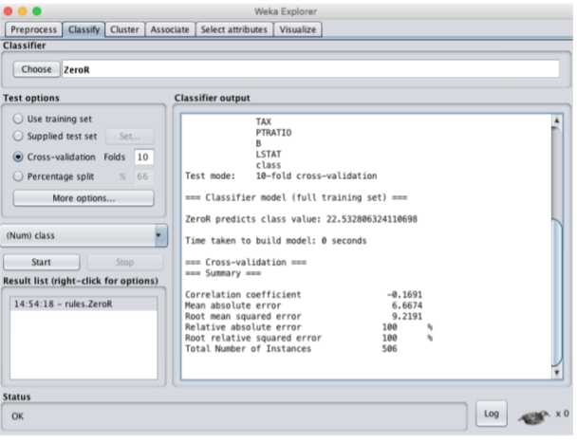
Classify

Slide 17
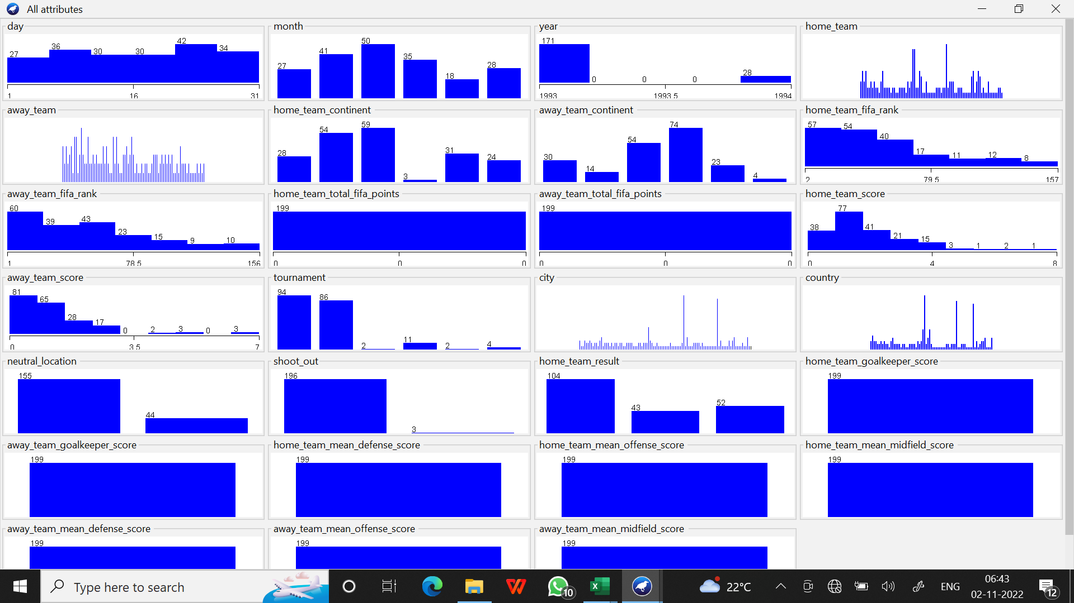
VISUALIZATION

Slide 18
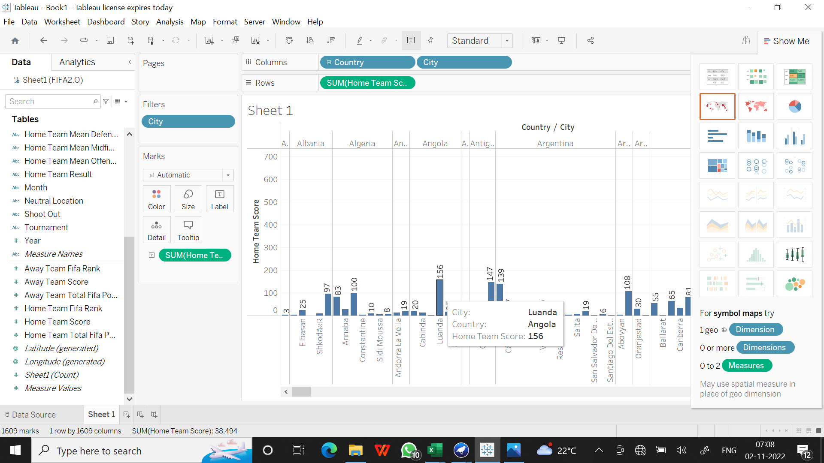
Visualization in Tableau

Slide 19
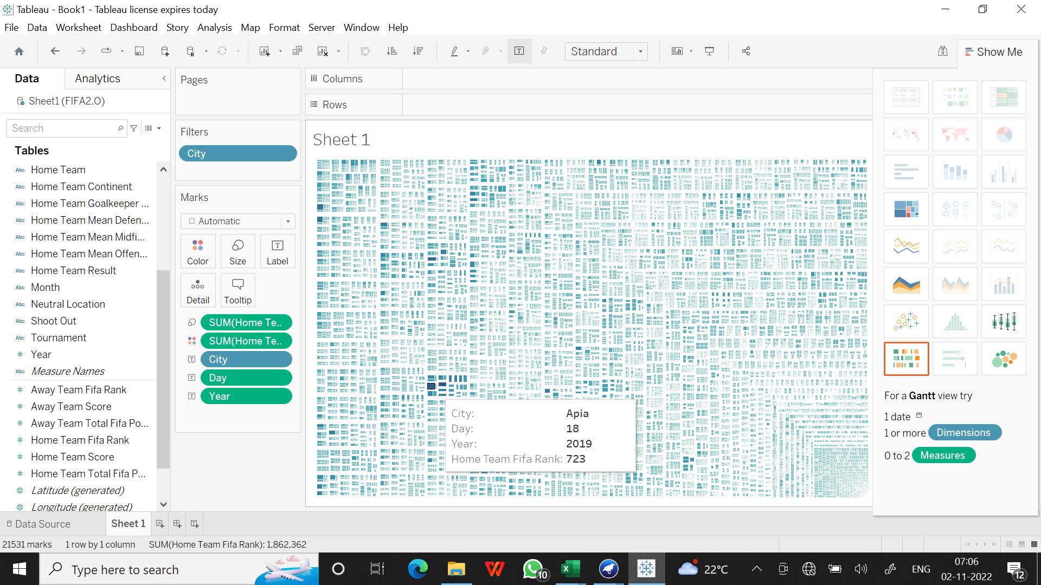

Slide 20
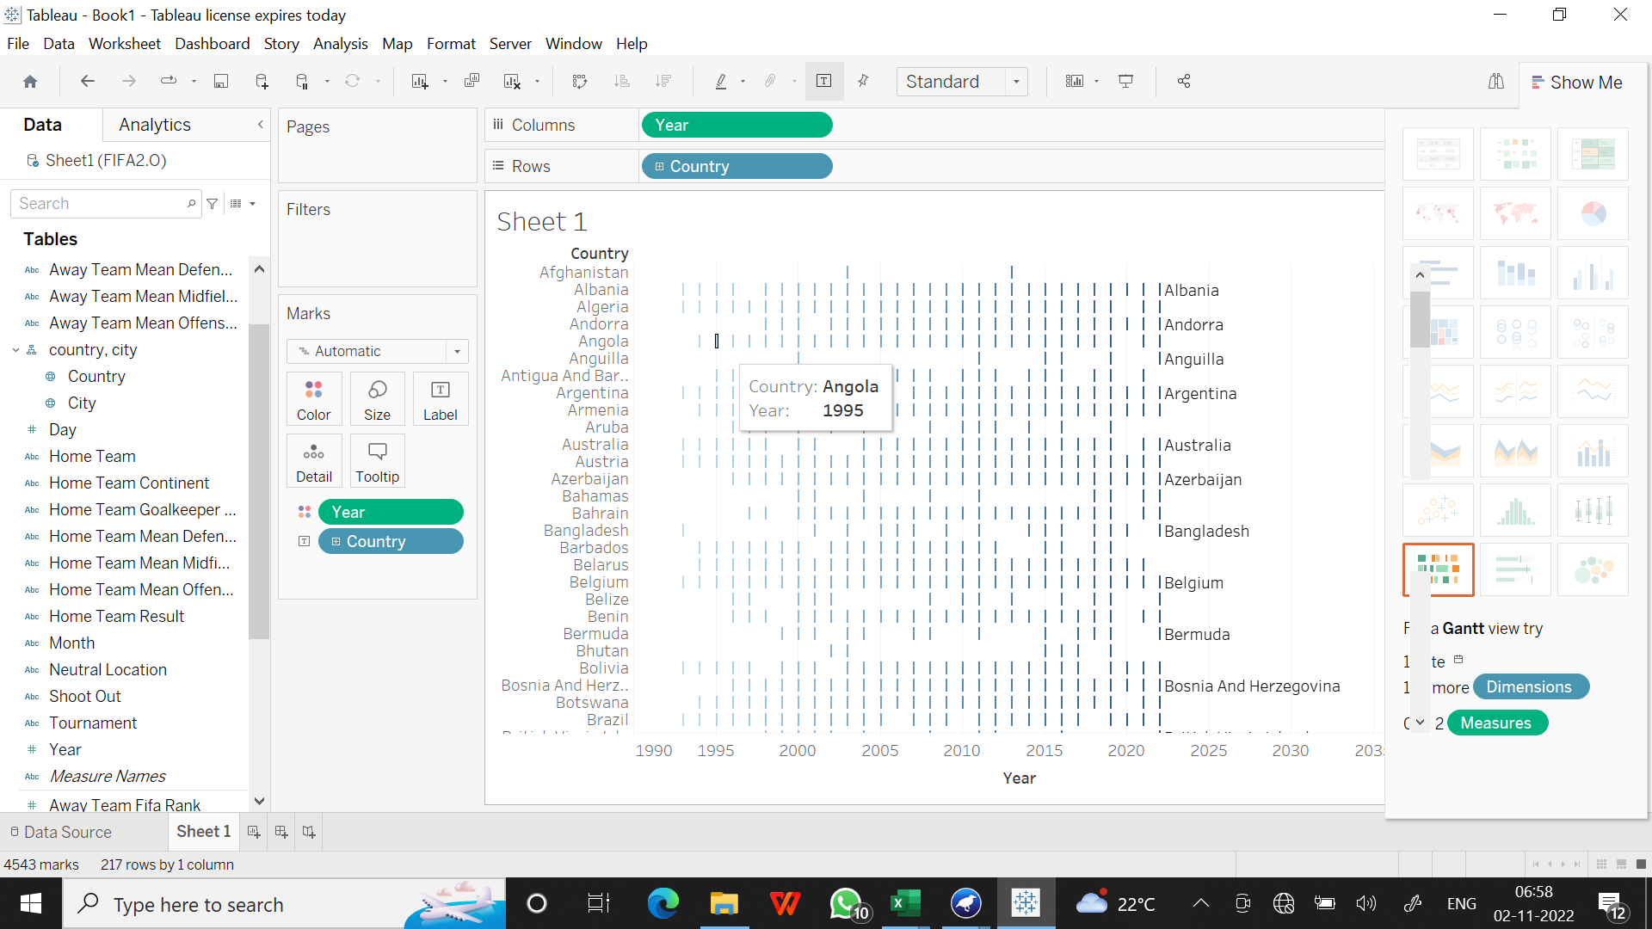

Slide 21
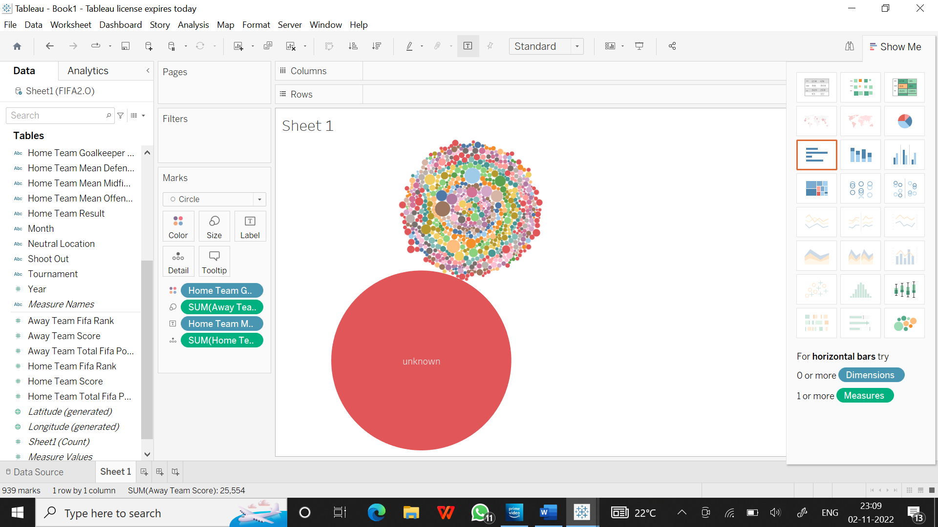

Slide 23
Thank you

